Slide 1
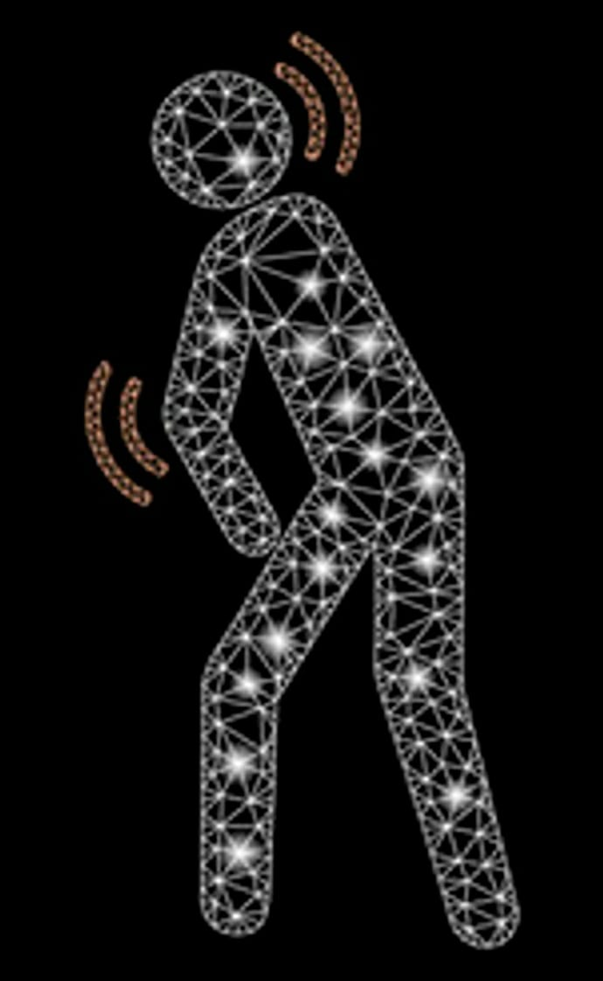

PREDICTION OF PARKINSON’S DISEASE USING ML CLASSIFIERS
TEAM MEMBERS:
K. THEJA KUMAR - 18121086
C. SRUJANA REDDY - 18121092
B. SAHITHI - 18121075

Slide 2
Abstract
In this Project, our main objective is to compare all possible Machine learning classification Algorithms to create best model out of it.
The dataset is taken from the UCI machine learning repository namely-Parkinson disease dataset with replicated acoustic features.
Various machine leaning techniques can be used and then the accuracy of the classifiers can be compared.
The classifier which gives highest accuracy can be selected as this a medical application we generally require more accuracy and efficiency that can't be compromised.
This model will be very helpful to doctors in order to say that the Patient is suffering with Parkinson or not.

Slide 3
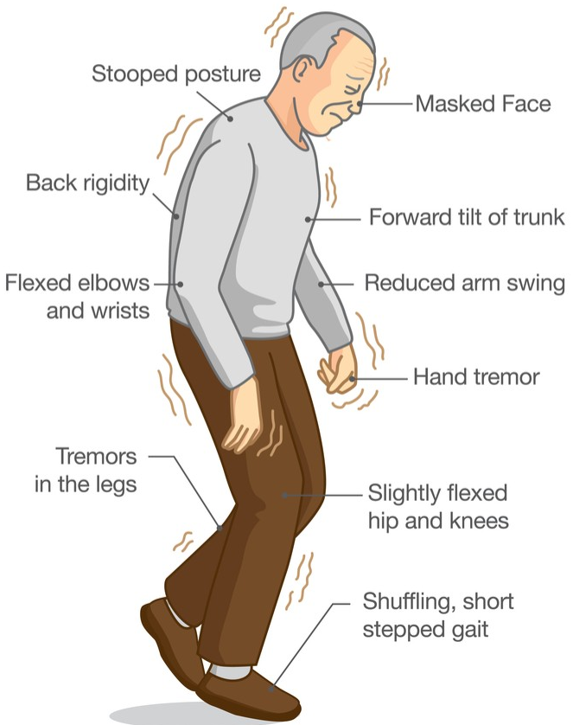
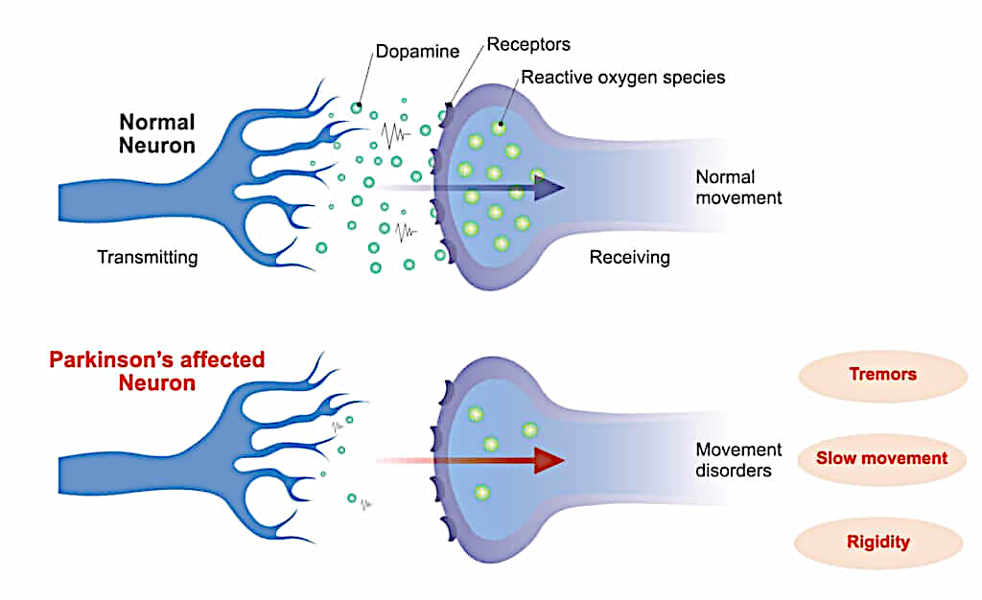
Introduction
Parkinson's disease is second most common neurological disorder that leads to shaking, stiffness, and difficulty with walking, balance, and coordination.
Parkinson’s disease is observed in people who are above 50 years old.
Nerve cell damage in the brain causes dopamine levels to drop, leading to the symptoms of Parkinson’s.
More than 1 million cases per year are being recorded in India.

Slide 4
Stages of Parkinson’s Disease
Stage One
Individuals experience mild symptoms that generally do not interfere with daily activities. Tremor and other movement symptoms occur on one side of the body only. They may also experience changes in posture, walking and facial expressions.
Stage Two
Symptoms worsen, including tremor, rigidity and other movement symptoms on both sides of the body. The person is still able to live alone, but daily tasks are more difficult and lengthier.
Stage Three
This is considered mid-stage. Individuals experience loss of balance and slowness of movements. While still fully independent, these symptoms significantly impair activities such as dressing and eating. Falls are also more common by stage three.
Stage Four
Symptoms are severe and limiting. Individuals may stand without help, but movement likely requires a walker. People in stage four require help with daily activities and are unable to live alone.
Stage Five
Stiffness in the legs may make it impossible to stand or walk. The person requires a wheelchair or is bedridden. Around-the-clock nursing care is needed for all activities. The person may experience hallucinations and delusions.

Slide 5
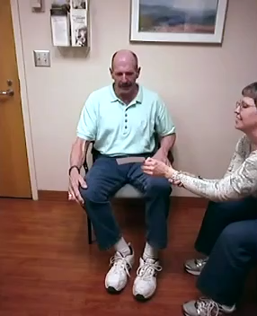

Parkinson’s Patient at stage 5

Slide 6
Symptoms and Alternative diseases
Tremor in hands, arms, legs, jaw,chin - Essential tremor (ET), Neuropathic, Dystonic, Etc.
Stiffness of the limbs and trunk - Cerebral palsy, Stiff-person syndrome, Etc.
Slowness of movement – Bradykinesia, restless legs syndrome, Etc.
Impaired balance and coordination – Ataxia, Meniere's disease(Vertigo) Etc
Speech changes - Alzheimer’s, Laryngitis, Etc.
Writing changes – ataxia, Essential tremor, Dystonic, Etc
Trouble Sleeping – Insomnia, Narcolepsy, Etc
Masked Face - progressive supranuclear palsy(PSP), Moebius syndrome, Etc
Difficulty Swallowing – dysphagia, amyotrophic lateral sclerosis(ALS), Etc

Slide 7
Literature survey
[1] Ashish Kolte used Gaussian naive bayes classifier after applying k-best feature selection and normalization on training data and got maximum accuracy of 86.25% at k=40.(IEEE -2019)
[2] Ibrahim Karabayir used Random Forest (81.8%), Logistic Regression(77.1%), SVM(74.4%), Extreme Gradient Boosting(81.6%), KNN(76%) and used Least Absolute Shrinkage and Selection Operator(LASSO) for feature selections.(BMC Medical Informatics Journal - 2020)
[3] Lizbeth Naranjo used novel subject-based Bayesian classification(87.1%) and used all features for building a model.(Elsevier Journal- 2016)
[4] A Yasar used Artificial neural networks using MATLAB using complete data and obtained 94% accuracy.(IOP Conference Series: Materials Science and Engineering - 2019)

Slide 8

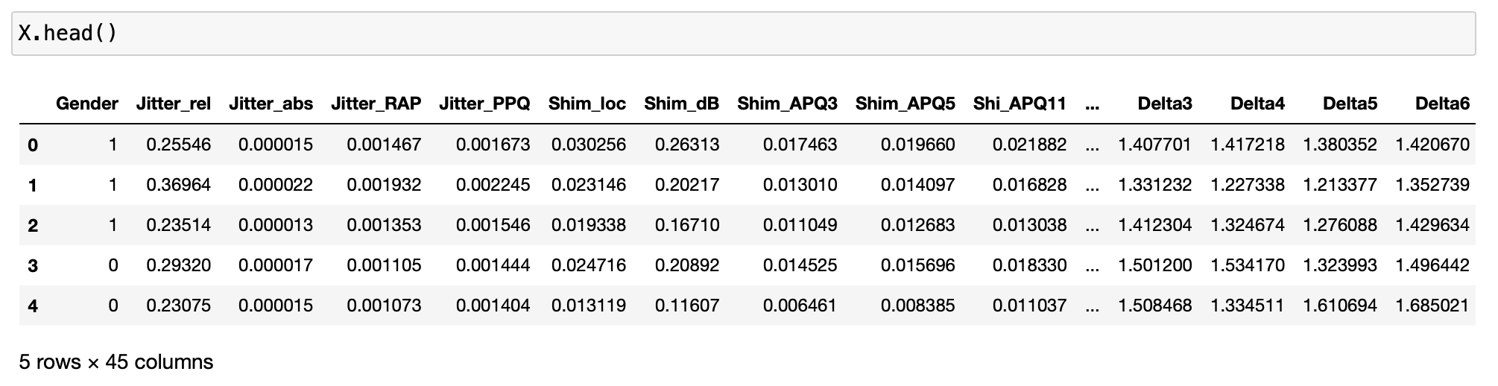
Dataset
There are 48 Attributes present in the dataset pertaining to the disease for 240 Instances.
In 48 Attributes the dataset have 45 features of the sample.
Out of 240 recordings, 120 are recordings from Parkinson’s patients and remaining 120 are healthy.

Slide 9
Libraries
Feature Selection methods
Machine Learning Classifiers
Numpy
Pandas
Matplot
Seaborn
Sklearn
Xgboost
Lightgbm(lgb)
Pearson correlation coefficient
Information Gain(mutual_info)
Univariate Selection Method
Feature Importance
Stochastic Gradient Descent
Gradient Descent
K-Nearest Neighbours
Decision Tree
Random Forest
Support Vector Machine
Logistic Regression
Gaussian naive bayes
Extreme Gradient Boosting (XGB)
Light Gradient Boosting (LGB)

Slide 10
Reference
[1] A. Kolte, B. Mahitha and N. V. G. Raju, "Stratification of Parkinson Disease using python scikit-learn ML library," 2019 International Conference on Emerging Trends in Science and Engineering (ICESE), 2019, pp. 1-4, doi: 10.1109/ICESE46178.2019.9194627.
[2] Karabayir, I., Goldman, S.M., Pappu, S. et al. Gradient boosting for Parkinson’s disease diagnosis from voice recordings. BMC Med Inform Decis Mak 20, 228 (2020). https://doi.org/10.1186/s12911-020-01250-7
[3] Lizbeth Naranjo, Carlos J. Pérez, Yolanda Campos-Roca, Jacinto Martín, Addressing voice recording replications for Parkinson’s disease detection, Expert Systems with Applications, Volume 46,2016,Pages 286-292,ISSN 0957-4174,https://doi.org/10.1016/j.eswa.2015.10.034.
[4] A Yasar, I Saritas, M A Sahman and A C Cinar, Classification of Parkinson disease data with artificial neural networks, IOP Conf. Series: Materials Science and Engineering 675 (2019) 012031 doi:10.1088/1757-899X/675/1/012031

Slide 11




THANK YOU

Slide 12
Libraries using
Feature selection methods & model Methods .. Use table for method names..
Images
Video

Slide 13
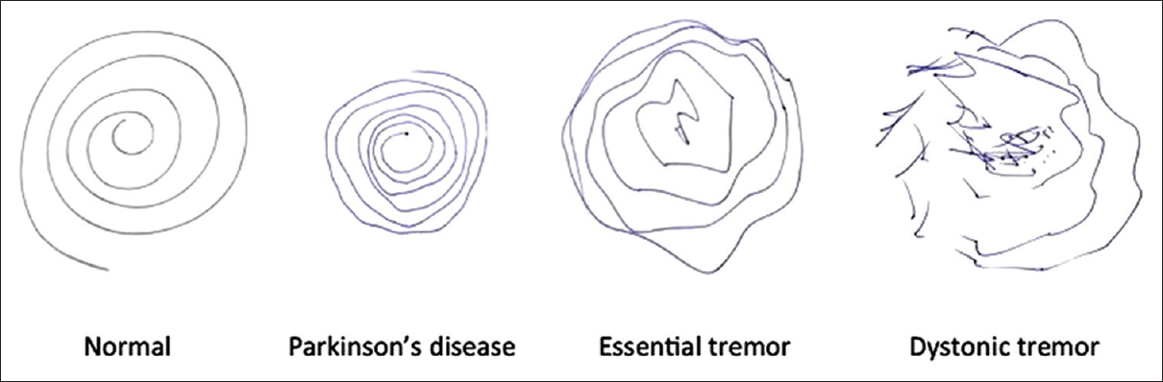
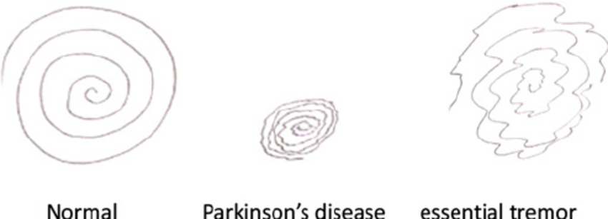
Archimedes-spirals

Slide 14
Dataset
Attributes in Dataset
ID: Subject's identifier.
Status: 0=Healthy; 1=PD
Gender: 0=Man; 1=Woman
Pitch local perturbation measures: relative jitter (Jitter_rel), absolute jitter (Jitter_abs), relative average perturbation (Jitter_RAP), and pitch perturbation quotient (Jitter_PPQ).
Amplitude perturbation measures: local shimmer (Shim_loc), shimmer in dB (Shim_dB), 3-point amplitude perturbation quotient (Shim_APQ3), 5-point amplitude perturbation quotient (Shim_APQ5), and 11-point amplitude perturbation quotient (Shim_APQ11).
Harmonic-to-noise ratio measures: harmonic-to-noise ratio in the frequency band 0-500 Hz (HNR05), in 0-1500 Hz (HNR15), in 0-2500 Hz (HNR25), in 0-3500 Hz (HNR35), and in 0-3800 Hz (HNR38).
Mel frequency cepstral coefficient-based spectral measures of order 0 to 12 (MFCC0, MFCC1,..., MFCC12) and their derivatives (Delta0, Delta1,..., Delta12).
Recurrence period density entropy (RPDE).
Detrended fluctuation analysis (DFA).
Pitch period entropy (PPE).
Glottal-to-noise excitation ratio (GNE).

Slide 15
He also used random forest(85%, k=40), Gradient Boosting(81.25%,all), support vector regression(85%, k=40).

